Slide 1

FLIGHT ANALYST
Predict Delays/Cancellations
Predict Flight Prices

Slide 2



Our Amazing Team-9
Ayushi Srivastava
Bhavesh Patel
Ila Nigam

Slide 3
Business Problem Overview
Flight delay is a challenging problem for all airline companies, which will lead to
●Financial losses and customer satisfaction
●Negative impact on their business reputation.
Cost of Delays in the US
$32.9B
$8.3B
$16.7B
$3.9B
$4B
GDP Impact
Cost to Airlines
Cost to Passengers
Cost from
Lost Demand

Slide 4
Business Problem Overview
Model
Predict
Flight Delay
Help
Airline Companies & Customers
Optimize operation
Reduce further loss
Increase Reputation
Model Predicts
Price of Flights
Forecast Price help Passengers

Slide 5
Literature Review
Airline industry incurs an average cost of about $11,300 per delayed flight.
Based on 61,000 delayed flights per month average
Excludes costs to passengers and lost demand
A more accurate delay prediction system can help to identify operational variables that contribute to delays/cancellation.

Slide 6

Data Understanding
From Research and Innovative Technology Administration,BTS
Contains detailed facets of each air flight information between 2014-2015. It is huge information which includes 21 variables like Destination, Origin, Arrival time, and Departure time, Departure Delay, Carrier etc

Slide 7
Data Understanding
Some potentially important Variables
Time
Flight Number
Quarter
Month;
Day of Month
Carrier
Departure Time,
Arrival Time
Airline
Departure Delay, Departure Delay 15, Cancellation
Geography
Origin And Destination Airport
Operations

Slide 8
Price Prediction Model
This would give consumers the best deals as the application may provide them with additional prices for dates above and below their travel date and save their cost of travel
Following Models were applied to build model to predict price of Flights:
Neural Network Regression
Linear regression
Boosted Decision Tree Regression
Poisson Regression
Decision Forest Regression
Bayesian Linear Regression

Slide 9
Comparison Of Models
 | Neural Network | Linear regression | Boosted Decision Tree | Poisson | Decision Forest | Bayesian Linear
MAE | 98.70 | 148.39 | 113.34 | 139.31 | 103.17 | 148.39
RMSE | 128.70 | 213.45 | 154.19 | 204.27 | 141.37 | 213.45
Relative Absolute error | 0.40 | 0.61 | 0.47 | 0.57 | 0.42 | 0.61
Relative squared error | 0.14 | 0.40 | 0.21 | 0.37 | 0.17 | 0.40
Coefficient of Determination | 0.85 | 0.59 | 0.78 | 0.62 | 0.82 | 0.59
Neural Network Is the best Model from above statistics

Slide 10
Arrival Delay Time Prediction Model
This model is used by airlines companies and customers for improving Financial losses and customer satisfaction
Following Models were applied to build model to predict price of Flights:
Linear regression
Boosted Decision Tree Regression
Decision Forest Regression
Bayesian Linear Regression

Slide 11
Comparison Of Models
 | Bayesian Linear | Linear regression | Boosted Decision Tree | Decision Forest
MAE | 4.99 | 4.99 | 4.96 | 5.5
RMSE | 9.84 | 9.84 | 9.91 | 12.39
Relative Absolute Error | 0.27 | 0.27 | 0.26 | 0.29
Relative Squared error | 0.07 | 0.07 | 0.07 | 0.12
Coefficient of Determination | 0.92 | 0.92 | 0.92 | 0.87
Boosted Decision Tree Is the best Model from above statistics

Slide 12
Flight Cancellation Classification Model
Passengers might have a good use of they cannot take a risk of flight getting cancelled and this can help them to reschedule a different flight or take necessary actions well in advance if they get to know that the flight might get cancelled
Following Models were applied:
Two class Decision Forest
Two class Decision Jungle
Two class Boosted Decision
Two class Logistic Regression

Slide 13
Comparison Of Models
 | Decision Forest | Decision Jungle | Boosted Decision | Logistic Regression
Accuracy | 0.979 | 0.978 | 0.98 | 0.978
Precision | 0.979 | 0.978 | 0.982 | 0.978
Recall | 1 | 1 | 0.998 | 1
AUC | 0.991 | 0.789 | 0.862 | 0.784
Decision Forest Is the best Model from above statistics

Slide 14
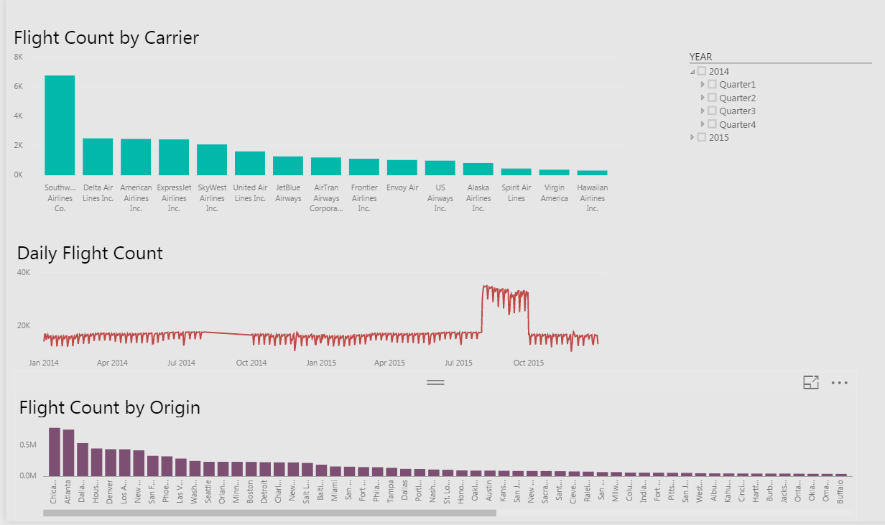
Data Visualization

Slide 15
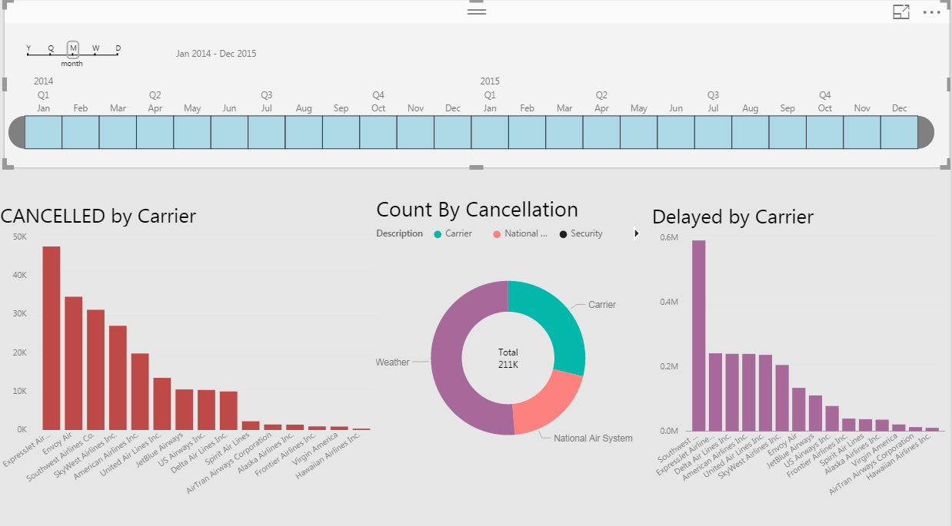
Data Visualization

Slide 16
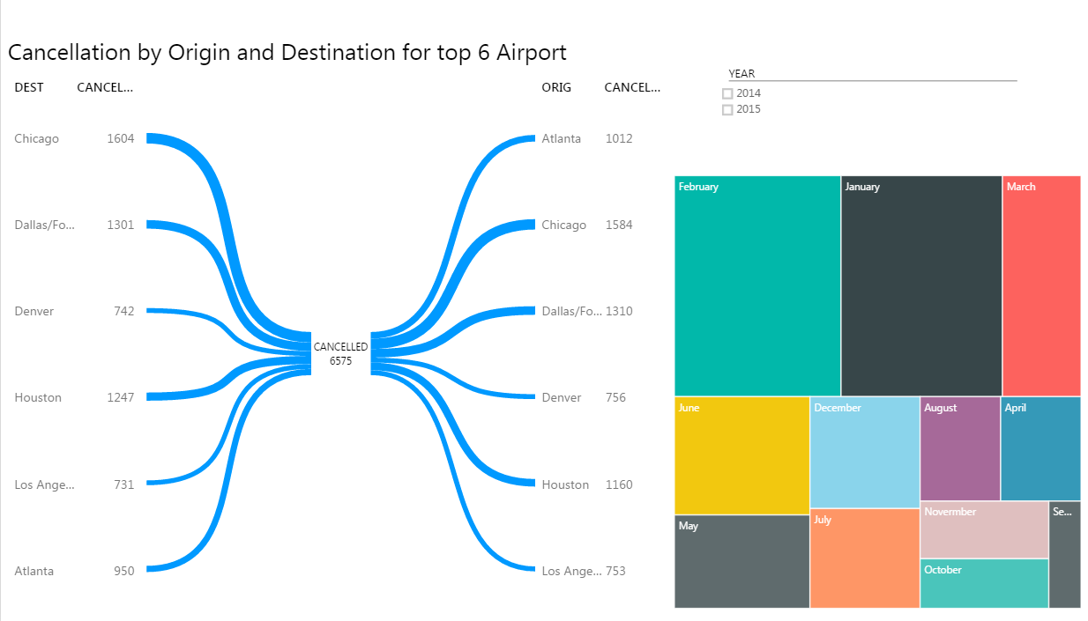
Data Visualization

Slide 17
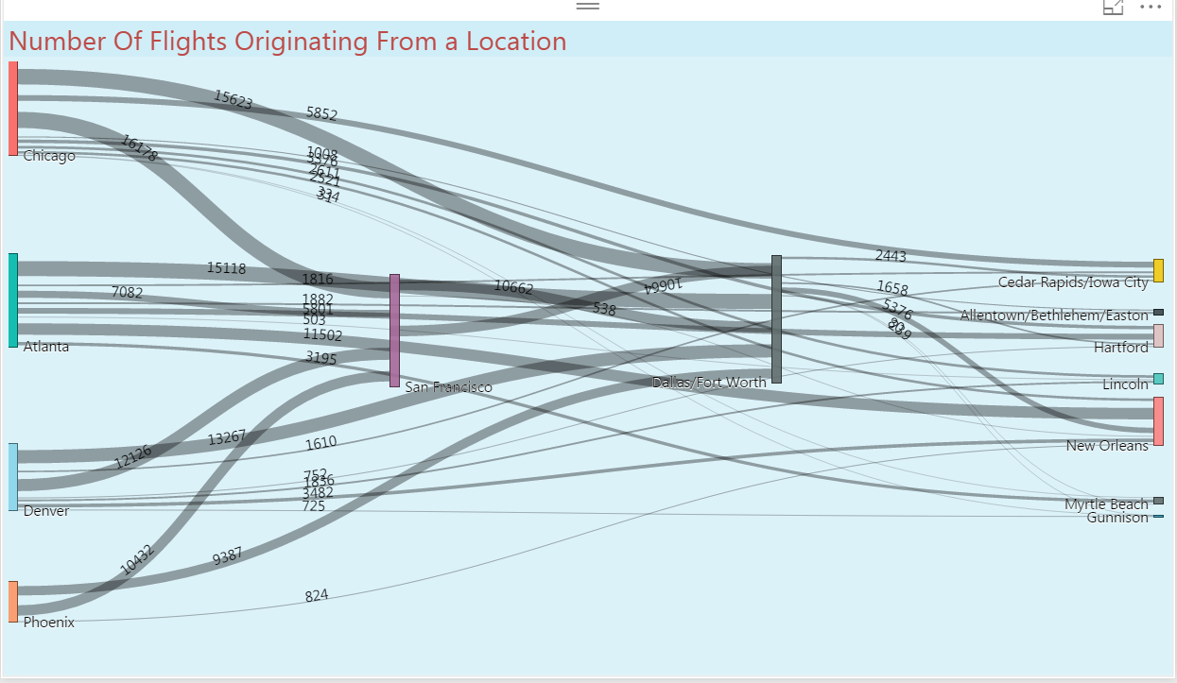
Data Visualization

Slide 18
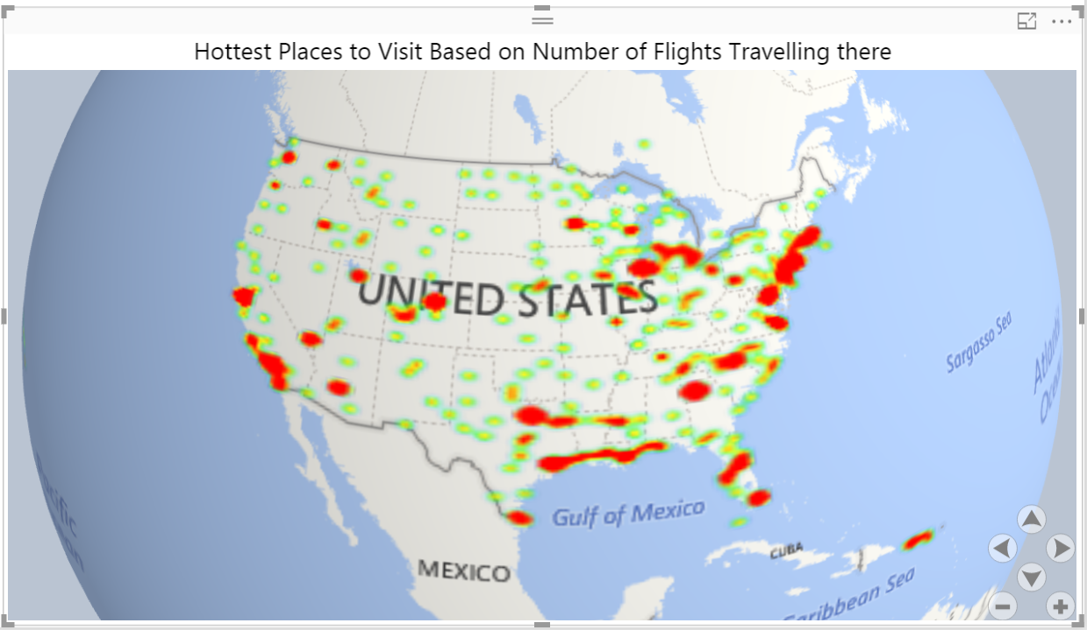
Data Visualization

Slide 19
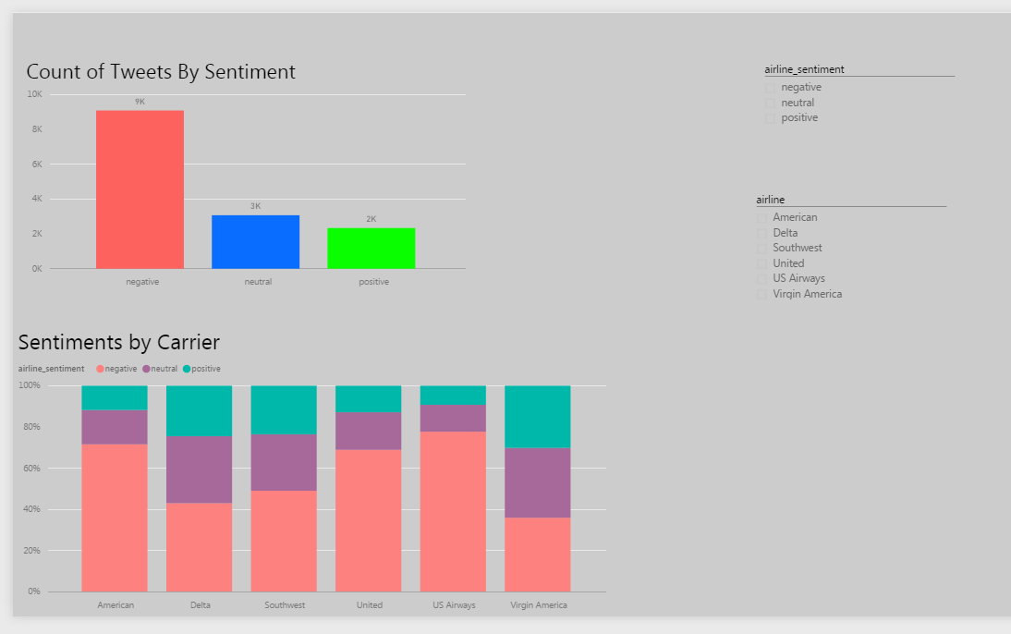
Twitter Sentiment Analysis for US Flights

Slide 20
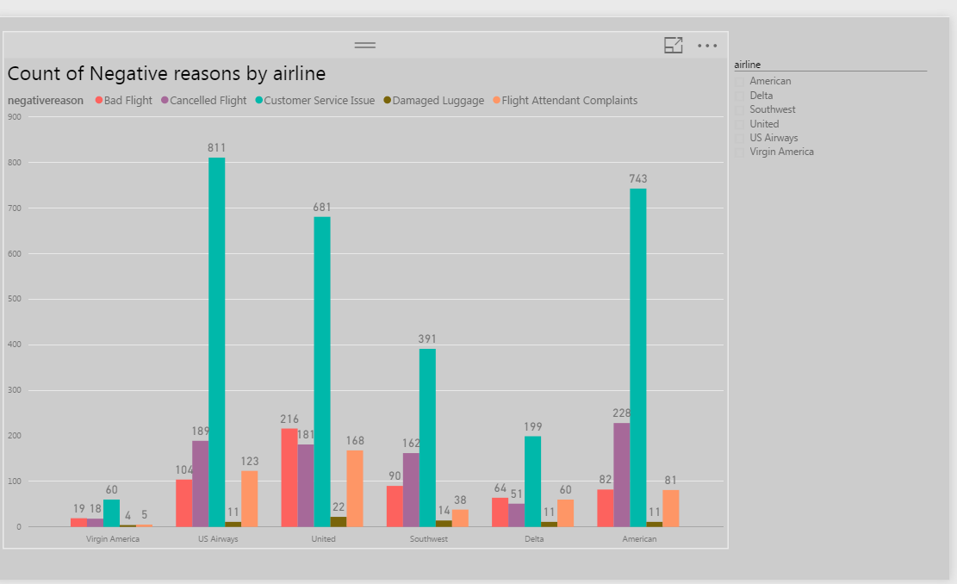
Twitter Sentiment Analysis for US Flights

Slide 21
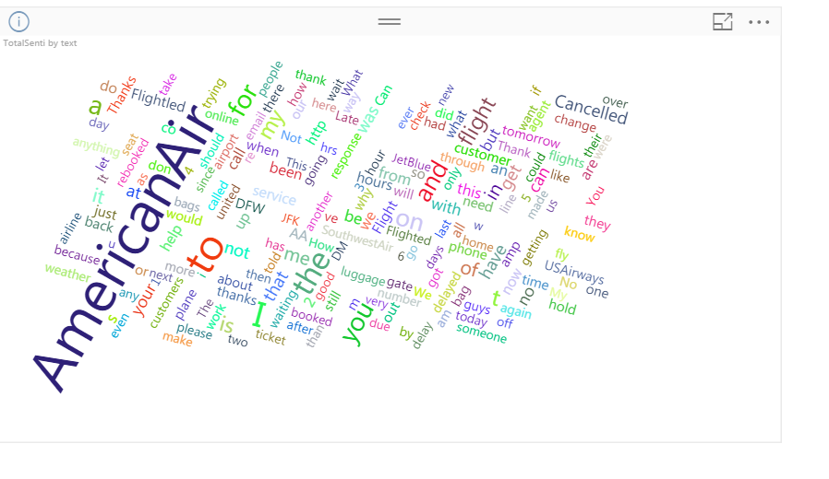
Twitter Sentiment Analysis for US Flights

Slide 22
Thank You…

